Slide 1

Land Service Info
Tritol (ত্রিতল)
Group - 13

Slide 2
The Concept
An application to provide information about LD tax payment and mutation services.

Slide 3
The Features
Registration
Information
Recent Updates
Other Land Related Services Info

Slide 4
What we developed in GDG
Idea
Wireframe

Slide 5
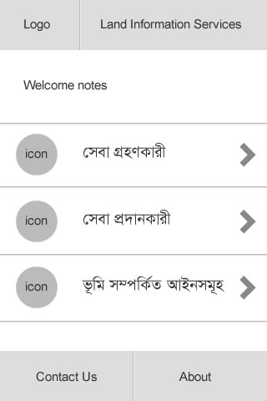
What we developed in GDG
This is the home screen of the App.
Here, a list of services category will be shown

Slide 6
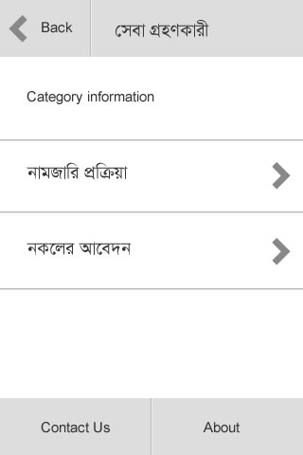
What we developed in GDG
Inner page

Slide 7
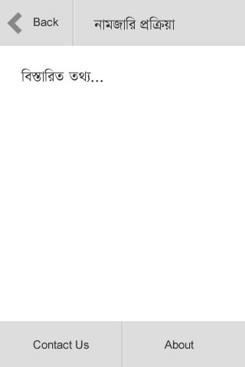
What we developed in GDG
Information & instruction will be displayed here

Slide 8
Final Vision
Land related service information
Development time : 7 Days

Slide 9
Supports We Need
Database Access
Sponsorship

Slide 10
Team Details
Team Leader:
Nasim Ahmed - sykot@yahoo.com - 01678726618
Members:
Nusrat Mahmud - nusrat.bracu@gmail.com - 01671040338
Fahmida Zahan - fahmida.zhn@gmail.com - 01928370882
Domain Expert:
Mahdi Hasan - mmhasan_du@yahoo.com – 01911916997
Github Link:
https://github.com/sykot

